Slide 1
American Sign Language Classification
Deep Learning (CNN)
Milan Patel

Slide 2
American Sign Language (ASL) Dataset
The dataset is a collection of images of alphabets from the ASL, separated in 29 folders which represent the various classes. The training data set contains 87,000 images which are 200x200 pixels. There are 29 classes, of which 26 are for the letters A-Z and 3 classes for SPACE, DELETE and NOTHING.

Slide 3
Objective
Given 87,000 images on ASL, the objective of this project is to develop and evaluate effective deep learning models for American Sign Language (ASL) classification, leveraging both custom convolutional neural networks (CNNs) and transfer learning with pretrained MobileNet, with the aim of optimizing accuracy, efficiency, and generalization in real-world applications.

Slide 4
BASE PLAN
Create a dataframe using asl alphabets images and storing image path with label in it.
Do EDA on it: finding out the count of images, distribution of each alphabet images, displaying 10 random images with labels, histogram of RGB channel values and analyzing it.
Split df into 3 splits: train, validation and test and use ImageDataGenerator to reduce size from 200x200 to 96x96 and then normalize values so that its easier to train it.
Try 3 different models: 2 custom models: 1 simple and the other little bit complex with hyperparameter tuning. 3rd model will be pretrained MobileNet model.

Slide 5
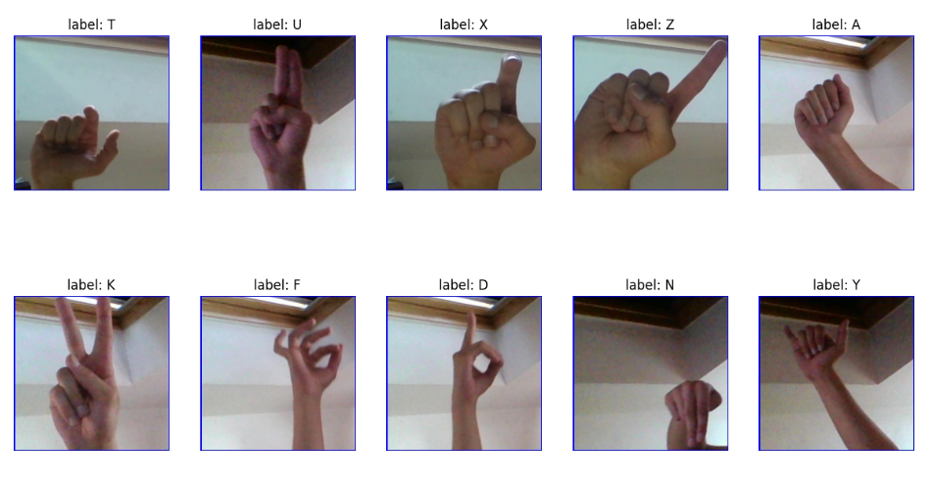
Dataset

Slide 6
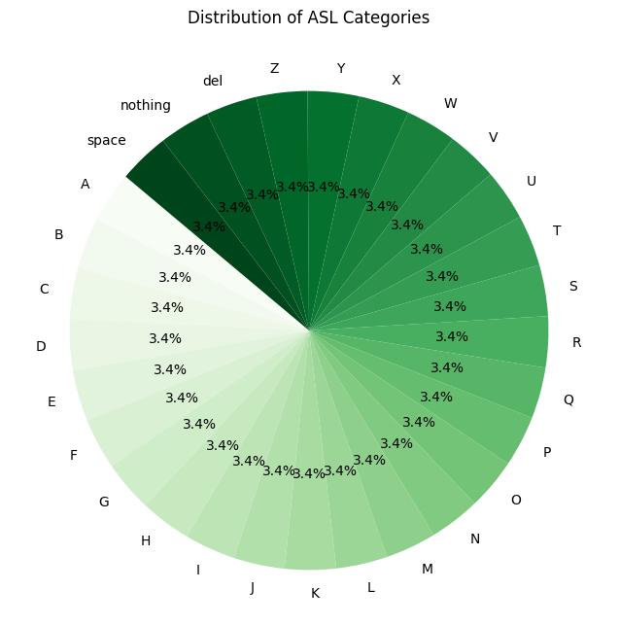

Slide 7
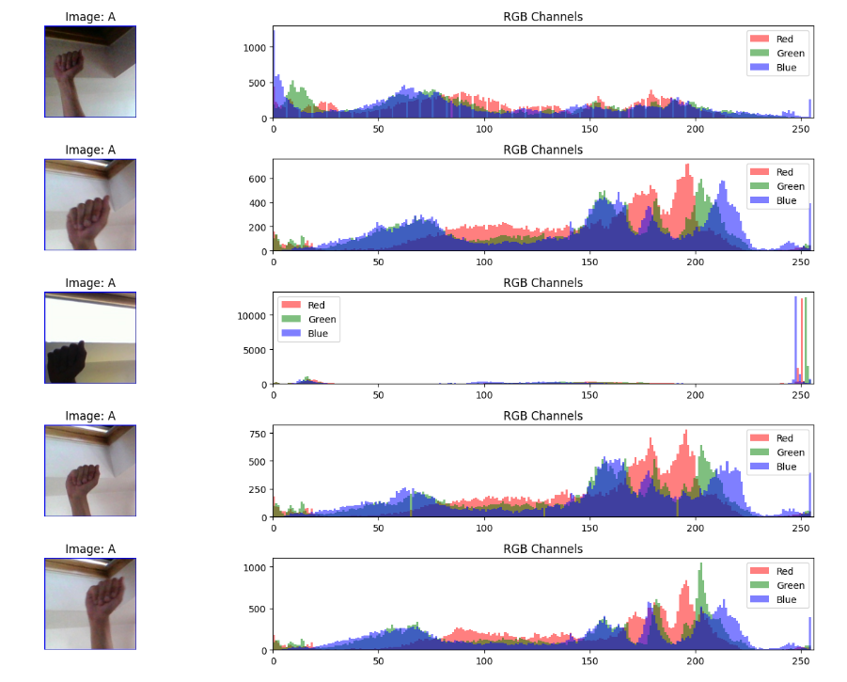

Slide 8
CNN Model 1 Architecture
Convolutional layers: The model uses three convolutional layers with increasing filter counts (32, 64, 128). This allows the network to learn hierarchical features, from simple edges to more complex patterns.
Max pooling: After each convolutional layer, max pooling reduces spatial dimensions, making the model more computationally efficient and helping to achieve spatial invariance.
ReLU activation: Used in convolutional layers, ReLU helps introduce non-linearity and can help mitigate the vanishing gradient problem.
Dropout: The 50% dropout before the final layer helps prevent overfitting by randomly deactivating half of the neurons during training.
Multiclass output using softmax: The final dense layer with softmax activation is appropriate for multiclass classification.

Slide 9
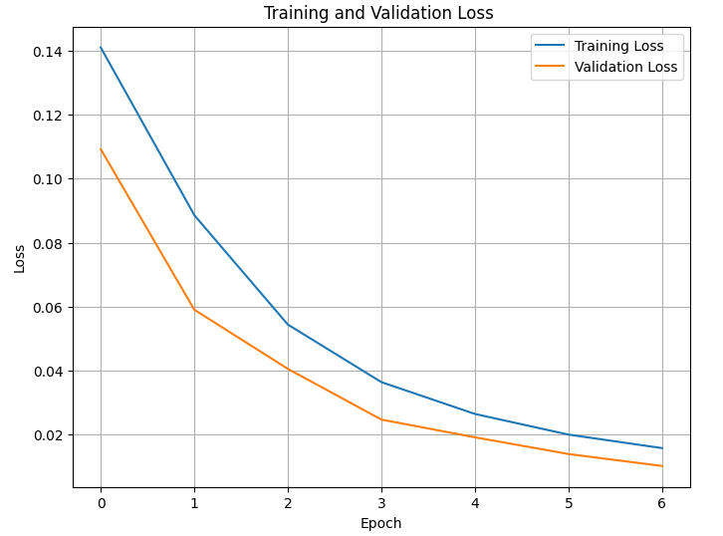
Model 1 Loss Graph

Slide 10
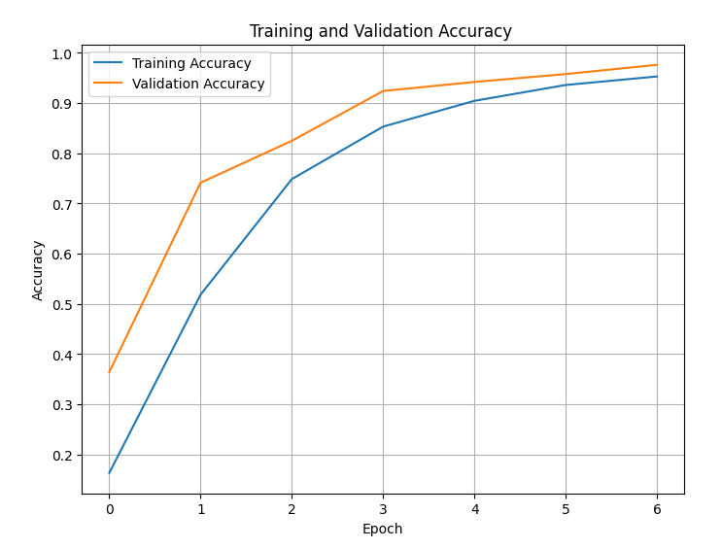
Model 1 Accuracy Graph

Slide 11
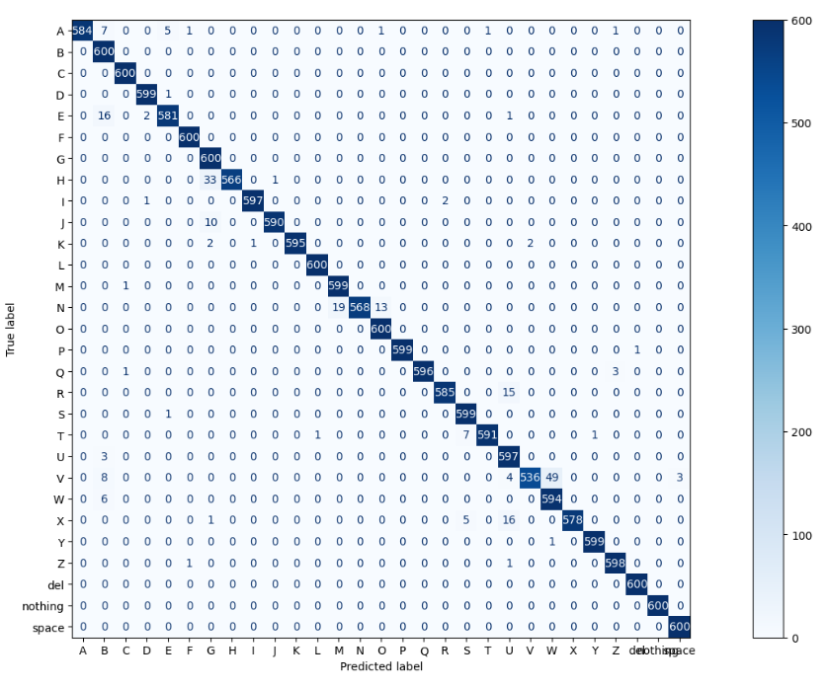

Slide 12
CNN Model 2 Architecture
This model is a deeper and more complex version of the previous architecture. With more convolutional layers, this model can potentially learn more complex features. Adam optimizer is also used which can adapt the learning rate during training. Also Batch normalizer is used to speed up the model's training time.

Slide 13
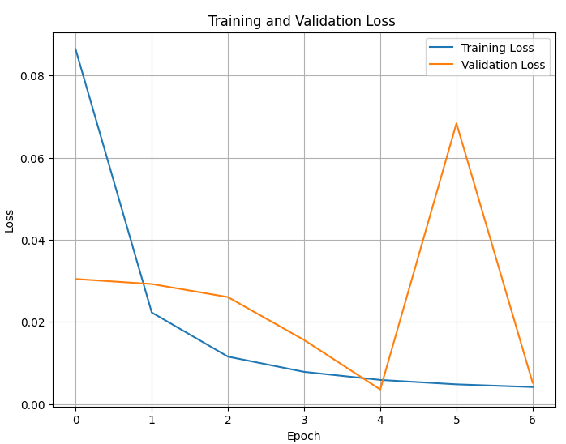
Model 2 Loss Graph

Slide 14
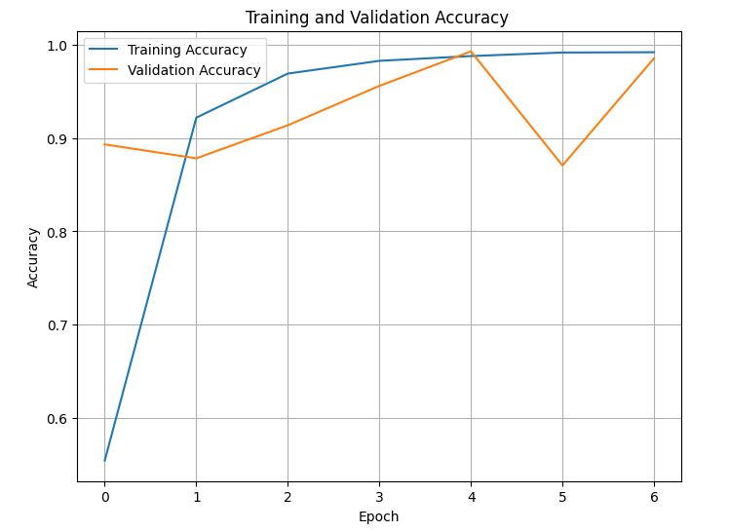
Model 2 Accuracy Graph

Slide 15
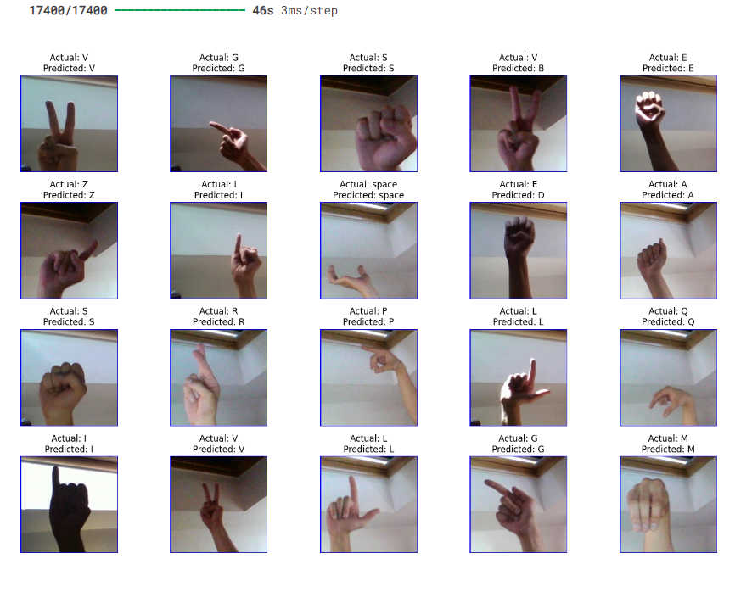

Slide 16
CNN Model 3: MobileNet
A type of convolutional neural network designed to be efficient and lightweight, making it ideal for mobile and embedded applications where computational resources are limited.
By freezing the base layers, it retains the learned features from ImageNet while allowing the added dense layers to specialize in recognizing ASL signs.

Slide 17
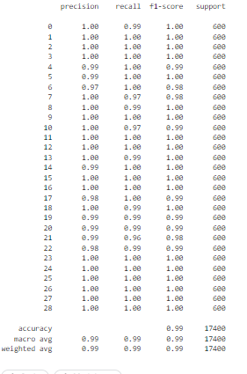
Model 3 Report

Slide 18
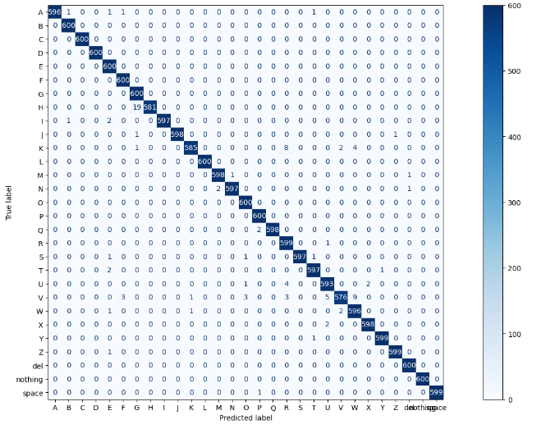

Slide 19
Summary
Experimented with three different models for ASL (American Sign Language) classification.
Model 1: Provides a balanced approach, with simpler layers and better generalization, making it a reliable option.
Model 2: Offers a deeper architecture, useful for complex tasks but prone to overfitting without sufficient regularization or data.
Model 3 (MobileNet): The top performer, leveraging transfer learning to deliver near-perfect accuracy and robust performance across all classes.
Overall, Model 3 with MobileNet stands out as the best choice, followed by Model 1 for its simplicity and stability, and Model 2 if deeper architectures are desired with appropriate measures to prevent overfitting.

Slide 20
Future Improvements
Moving forward, improvements could include exploring data augmentation to enhance generalization, fine-tuning a portion of the MobileNet layers for better feature extraction, and experimenting with more complex custom architectures like residual or attention mechanisms to push the performance further while maintaining a balance between accuracy and training time.

